Slide 1


SMART ROLL CALL
Automated Classroom Attendance Solution

Slide 2
Advantages of Smart Roll Call
Eliminates Proxy Attendance.
Saves time and helps teacher to conduct classes more efficiently.
Eliminates paper work.
Increases transparency between student, professor and parents.
Multiple student attendance report.
Light weight handheld portable device .
Easy integration with University management system (ERP).
Auto push of punch data to centralised server.
Mobile App for students and professors.

Slide 3
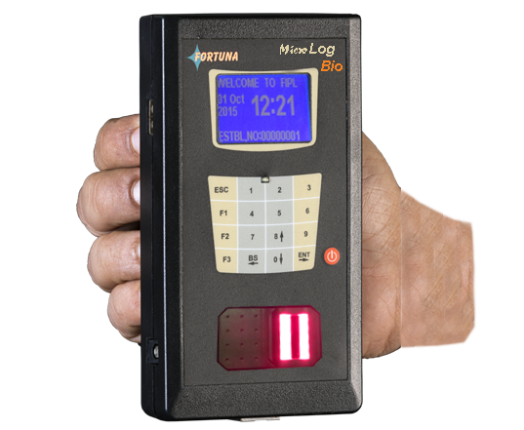
MICROLOGBIO Hand held Attendance recording system.
Microprocessor: 32-bit ARM CPU @ 120 MHz
Display:128x64 dot Graphic Display, EL backlight
Morpho- Sagem Sensor 6000 Finger Templates ( 3000 users with 2 Finger each)
Memory: 100,000 Transaction Records using FLASH
Voice Guided message (for Acceptance / Rejection) (with mute option)
Keyboard:16 keys with Membrane Keys
Communication : Automatic Server to Device Synchronization using Wi – Fi & LAN
Online Auto Data Push after Attendance is captured
Battery Back Up: Built-in 6 hours battery back up
Auto battery shut-down facility in case of idle condition
USB Interface
Working Temperature: 0°C-50°C/ RH: 20% to 95%(non condensing)

Slide 4
Hand Held Biometric Attendance solution :HARDWARE FEATURES
Real time attendance.
Easy Finger Enrolment of Students & Professors in the Hand held Terminals.
Professor Log-in & Professor logs out.
To Create new course including Course Name and Code.
Facility to download list of students , Course from the server.
Marking Missed Attendance.
Assigning the Course to the Professor .

Slide 5
USP’s of Micro LOG Bio : Hand Held Biometric Attendance solution:
Professor Login using Finger Punching for enabling Classroom Attendance & Log-out after Attendance is over.
Multiple Professors supported on a Single MicroLOG Bio
Each MicroLOG may have the following Database:
Students : 15000 relationship subject/prof/student
Subject : 96
The Transaction data provides the Student ID, Professor ID & the Course ID along with Date/Time for better MIS Reporting
Auto Battery shut-down facility in case of idle condition
Lightweight, Rugged & Indigenously designed & manufactured
Report Generation : Subject /Course wise
Daily/Monthly/Semester wise/Punch time wise Attendance & Absentee Report.

Slide 6
Application Flow
Step 1
One time Registration of Students and Professor Finger Print Templates for Biometric Attendance System.
Step 2
Downloading of the mapped relation of subject, professor & student in the handheld device.
Step 3
During each lecture professor logs in the device using his finger punch, thereafter select the subject and passes it to students for capturing their attendance.
Step 4
After completion of student punches, professors log-out, which is equivalent to closing the Attendance Register. The recorded data are pushed to Server in bulk mode & posted in the Application database for report generation.

Slide 7
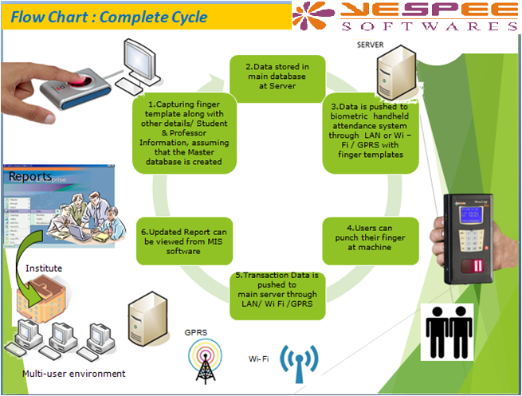
APPLICATION FLOW

Slide 8
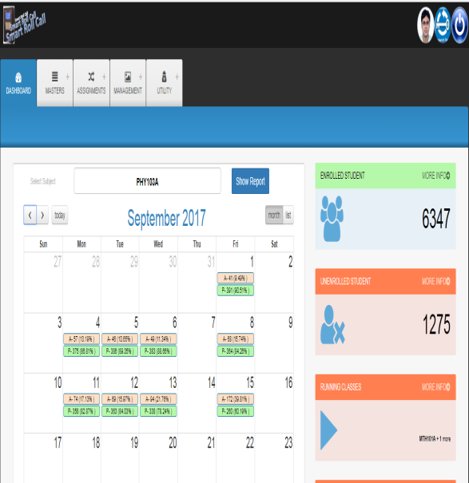
LIVE EXPERIENCE
Dashboard
Individual login for Professor, student and parents.
Multiple attendance reports on student attendance.
Mobile App for students.
Easy registration of students & Professors.
Add & drop facility.

Slide 9

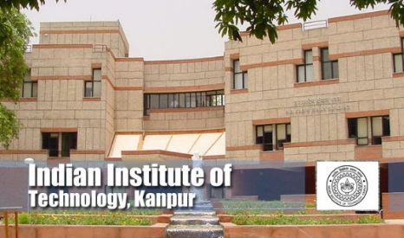
PLACES DEPLOYED
The Smart Roll Call Solution is currently successfully deployed in the under mentioned finest technical Institutions of India.
IIT Roorkee.
IIT Kanpur .
IIT Tirupati.
IIIT Hyderabad.
We also do the Integration of our Software with UMS ( University Management Software )

Slide 10
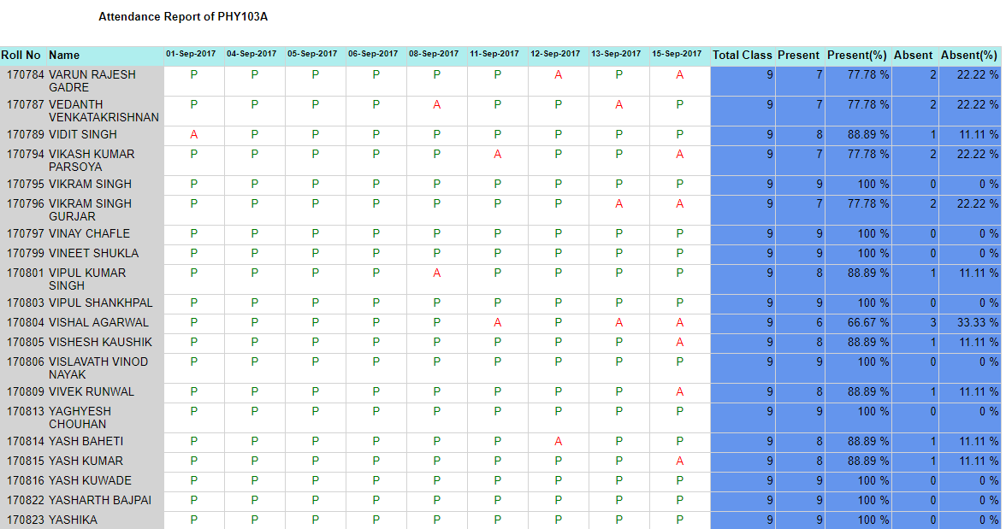
TYPES OF STUDENT ATTENDANCE REPORTS (MONTHLY)

Slide 11
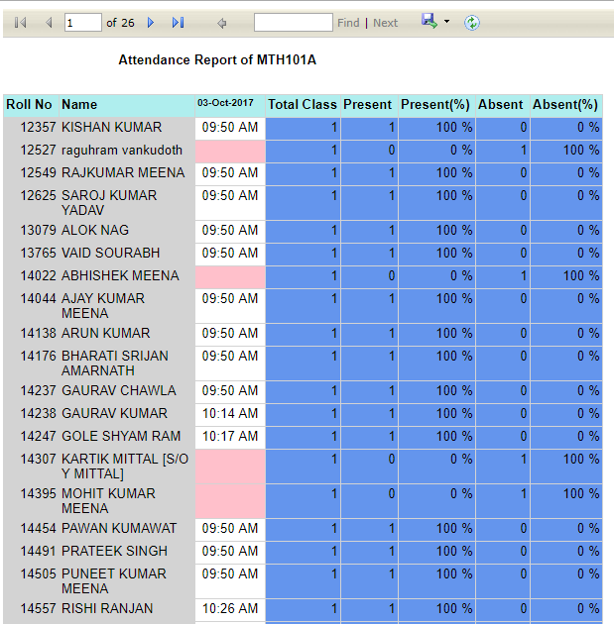
TYPES OF STUDENT ATTENDANCE REPORTS (DAY WISE PUNCH TIME REPORT)

Slide 12
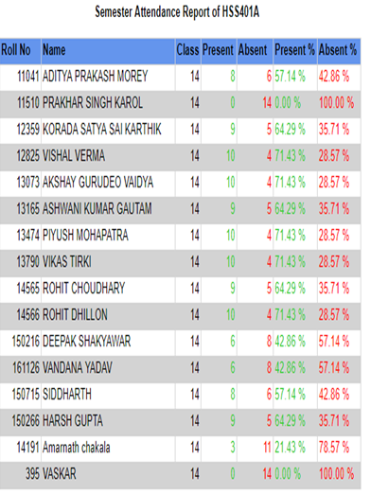
TYPES OF STUDENT ATTENDANCE REPORTS (SEMESTER WISE REPORT)

Slide 13
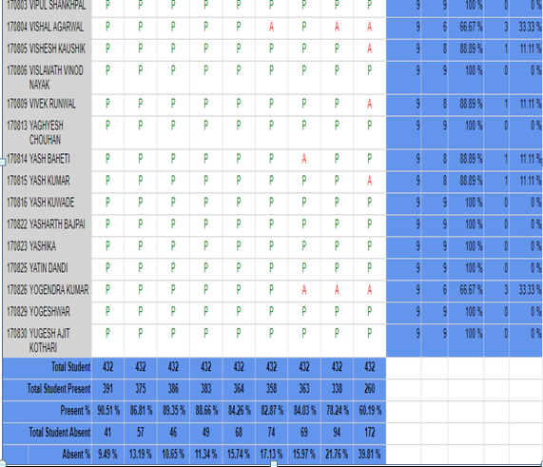
TYPES OF STUDENT ATTENDANCE REPORTS (CONSOLIDATED CLASS REPORT)

Slide 14

For more information, please feel free to contact

